Slide 1
Seoul Bike Share
Farin Hossain
Luke Zhang
Tianxia Yang
Zhiquan Cui
Notes:
Luke: O Annyeong! Annyeonghaseo
Luke: Jeou nuun Jimin from BTS-u imnida [I’m Jimin from BTS]
Luke: Bbu takk hanna-mman innuun daeyo. Ddowa juseyo [I need a favor. Please help me]
Summer: Uh sorry.. we don’t understand
Luke: Oh that’s okay, I’m not only native in Korean, I’m also fluent in English! Anyways, I’m a Korean business owner that runs a bike share. Could you help?
Summer: Korean? You don’t look-
Luke: Daanghyun najji! [Obviously!] I’m as Korean as can be, you calling me a liar?
Summer: Oh! No sorry sir. One look at you and it should’ve been obvious. Right.. Oh a bike sharing analysis? We’re doing exactly that at University of Toronto!
Luke: Ooo jing cha? Toronto dae ha? Go on then!

Slide 2
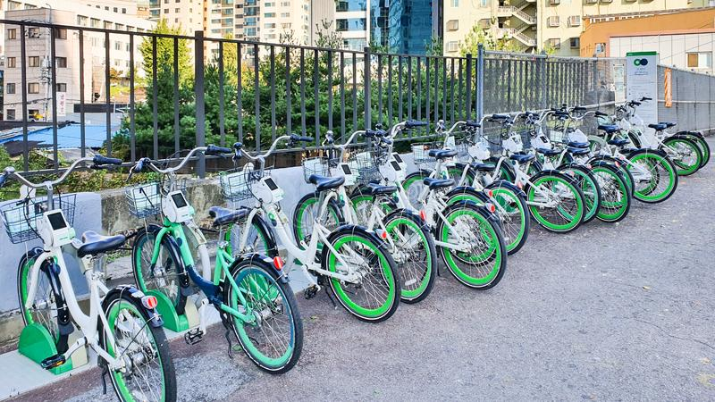

Research Context
How many bikes to provide?
Too few? Shortage :(
Too many? A waste of resources
Ddareungi
Notes:
Jimin’s business has been struggling to determine how many bikes to provide.
No bikes, means sad cyclists.
And too many bikes, means sad Jimin
We wouldn’t want THAT! So we’ll help predict the hourly demand of shared bikes.
Jimin: Kamsahamnida!!

Slide 3
1
The Data
EDA, cleaning, and collinearity check.
Notes:
Jimin, the quality of your data is even worse than your Korean!
Luke: what? Jing juh
Oh you don’t believe me? Well let’s take a look.

Slide 4
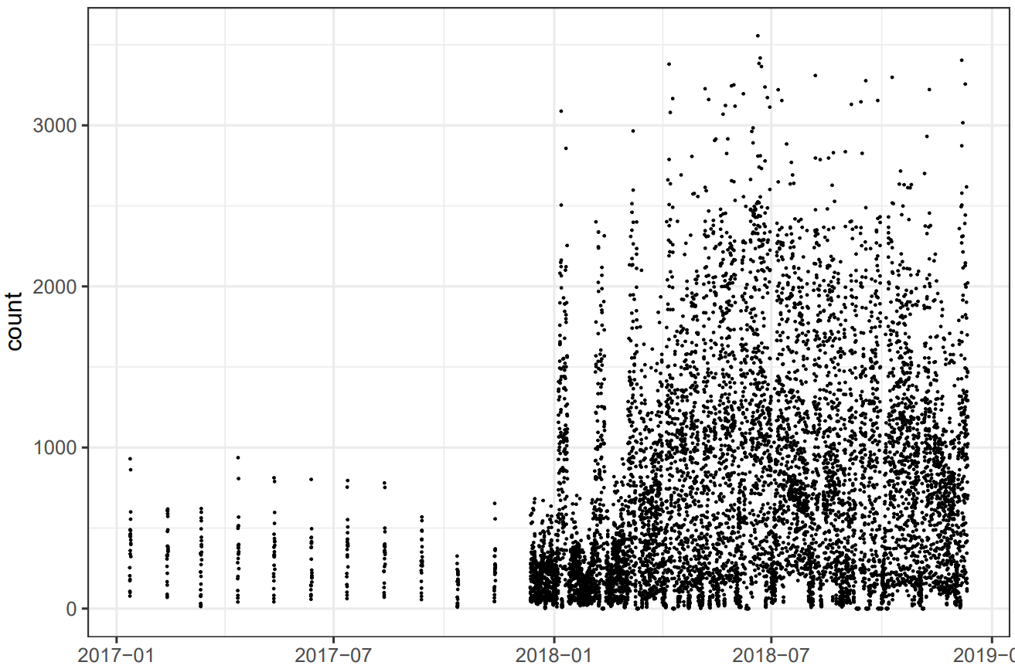
Inconsistent Data
Notes:
A simple time series plot revealed some problems, there’s a
-Large jump in hourly counts in 2018
-Inconsistent spacing between data points
Both suggest a change in data collection methods in 2018, so we sliced off 2017 data.

Slide 5
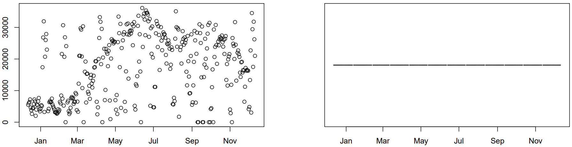
After Slicing
Daily Counts
Increments
The disparity has been removed
Spacing is now consistent
Notes:
After slicing,
The disparity gets removed,
and the spacing is now consistent.

Slide 6
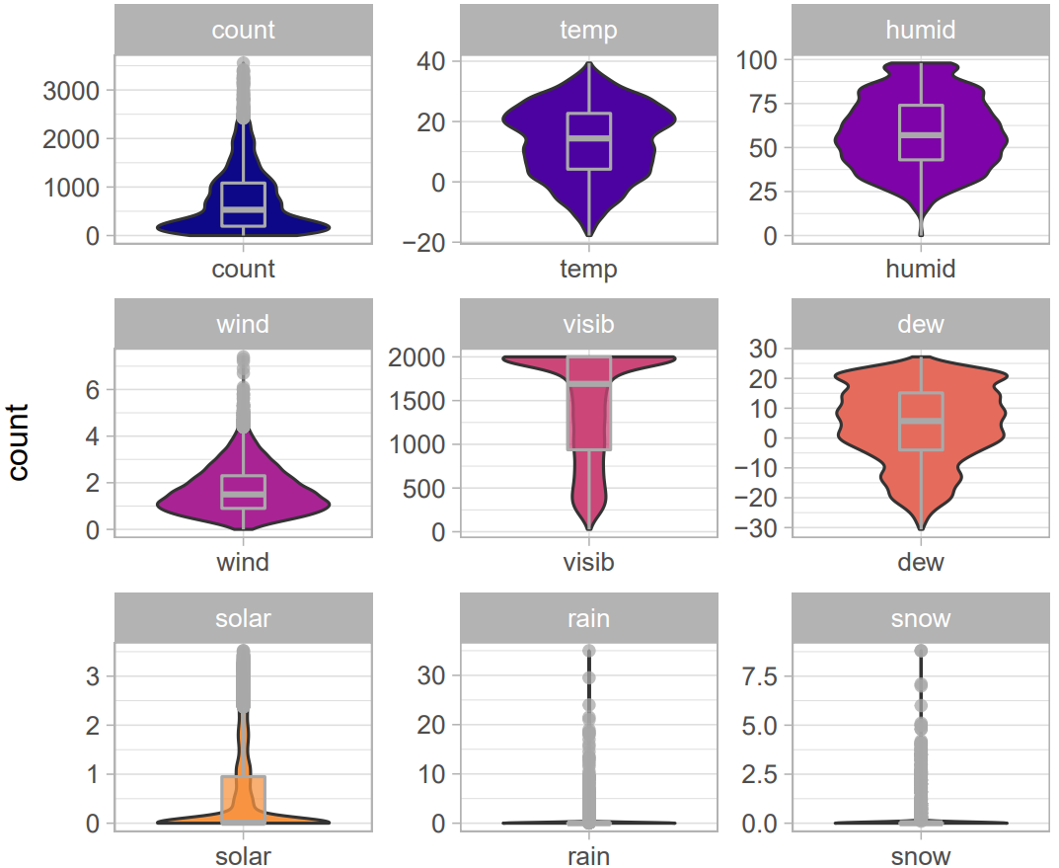
Quantitative Variables
Notes:
We used violin plots with box plots overlaid to see the distribution of our variables.
Count is our response variable
Temperature, humidity, wind, and so on are the other quantitative predictor variables.

Slide 7
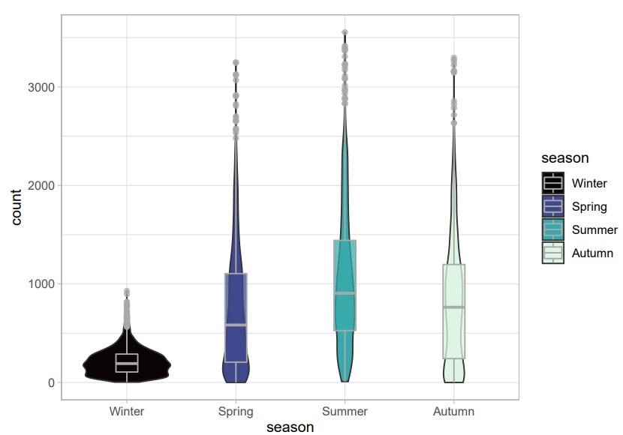
Qualitative Variables
Notes:
We did the same for our qualitative variables - which include season,

Slide 8
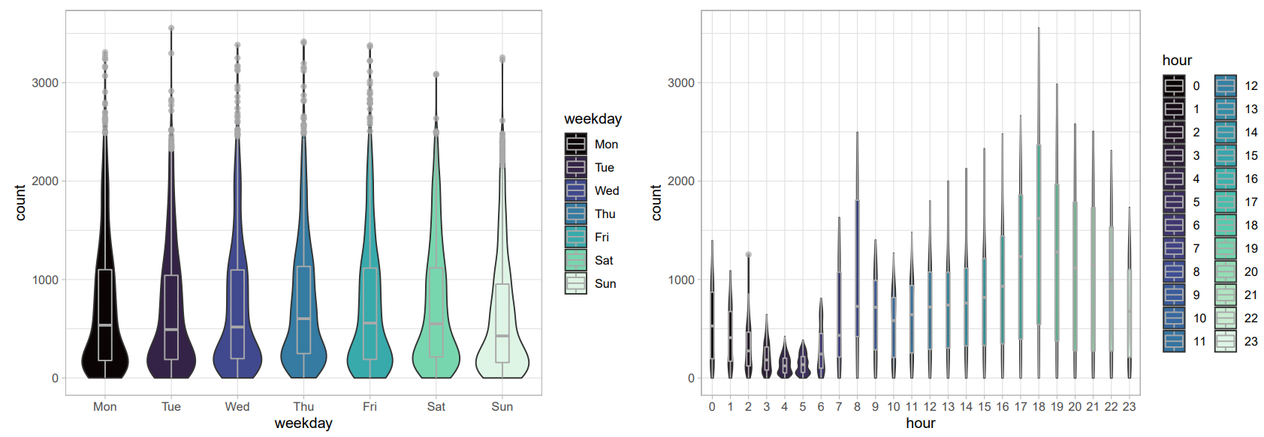
Qualitative Variables
Notes:
Weekday, Hour

Slide 9
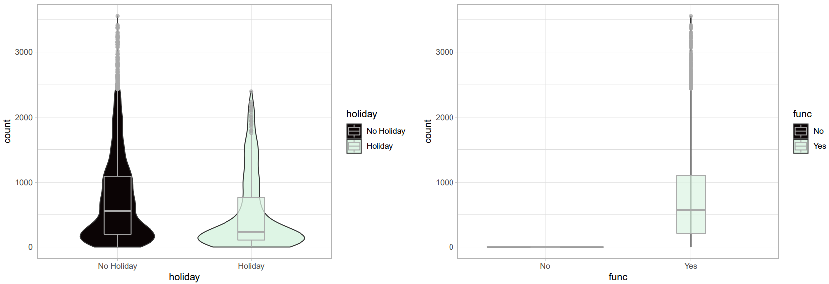
Qualitative Variables
Notes:
Holiday, and functional day

Slide 10
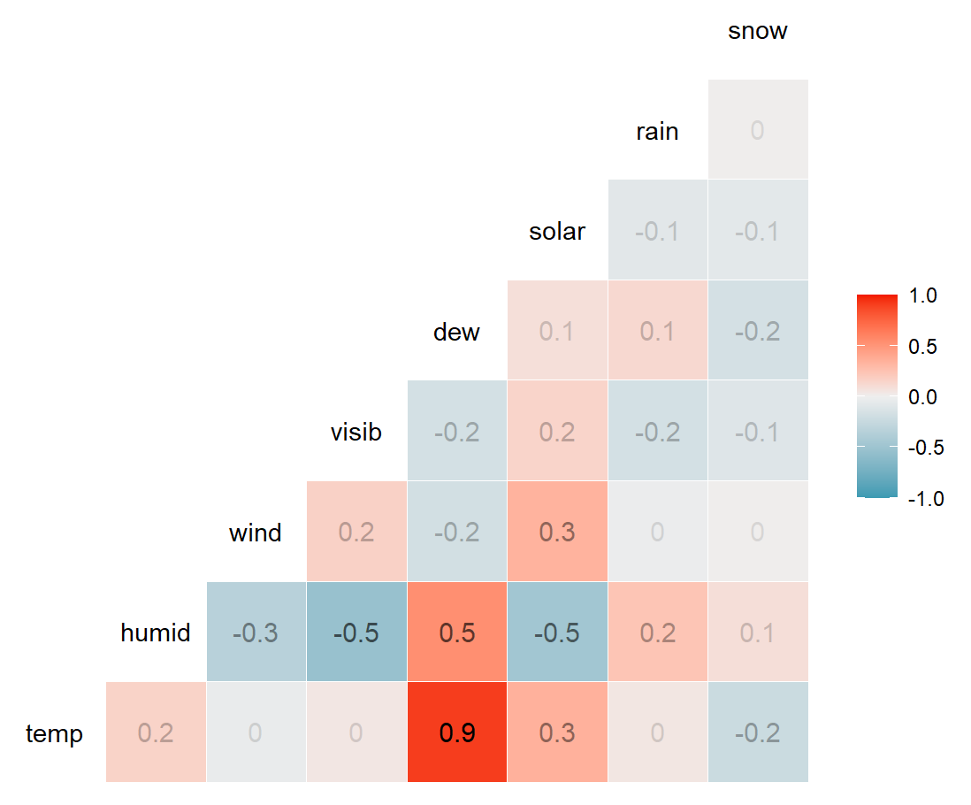
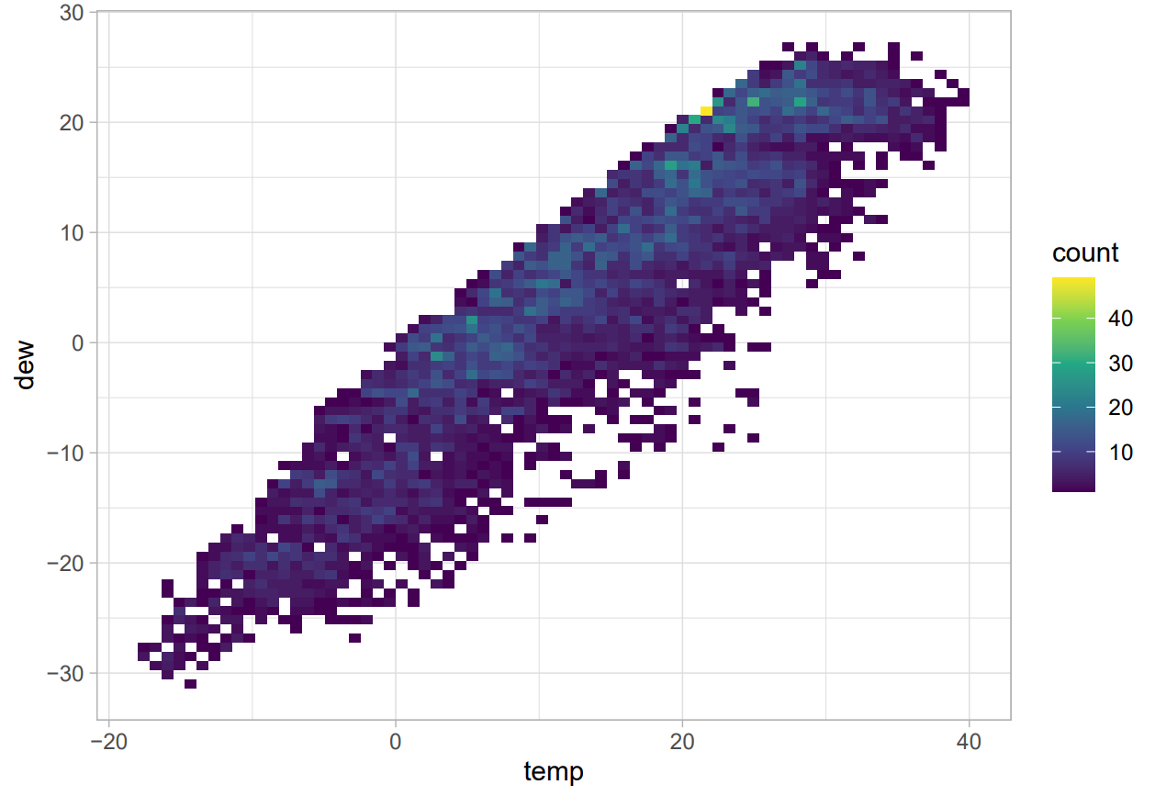
Correlation
Notes:
Plotting a heatmap of the correlation matrix, we notice that dew and temperature are highly correlated, and this is verified by the 2D density plot.
So, we removed “dew” from our model.

Slide 11
Temperature vs. Hour
Notes:
And look Jimin, we animated the hourly counts for each day, and colour coded the points using temperature!
Luke: JInja?? I wanna see the model now!

Slide 12
2
The Model
Model Building, Model Selection and Model Diagnostics
Notes:
Now, we’ll present the model building, selection and diagnostics.

Slide 13
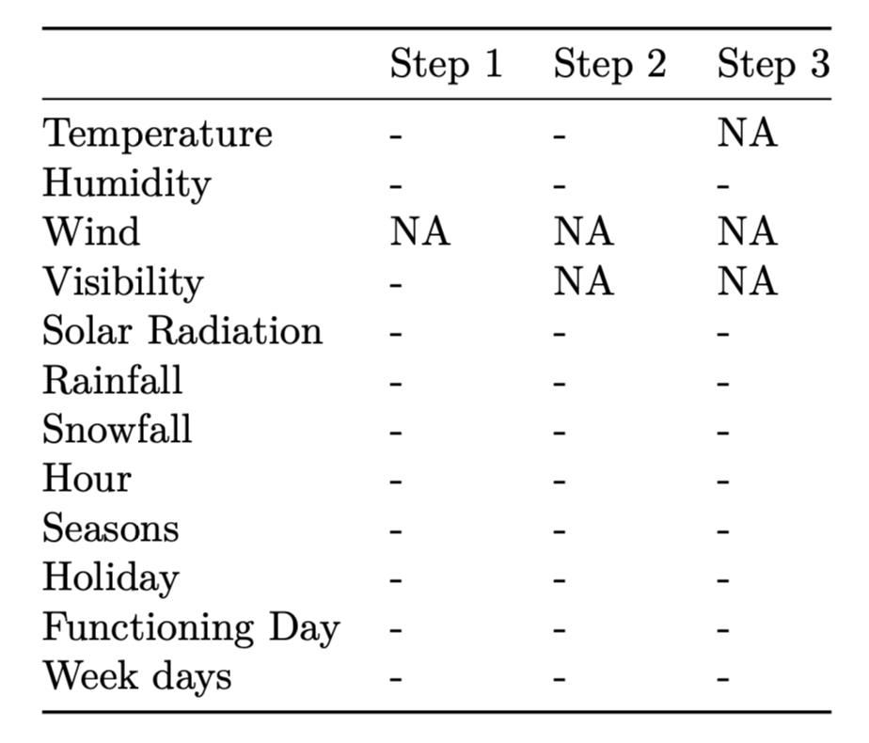
Main Effect Model
Stepwise Regression based on AIC:
Notes:
First, we built a main effect model and ran stepwise regression based on AIC. Notice that temperature, wind and visibility are dropped

Slide 14
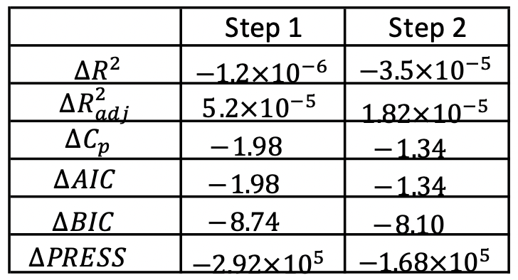
Main Effect Model
Stepwise Regression based on AIC:
Adjusted R Squared increases
AIC, BIC and PRESS decreases
Notes:
Notice that adjusted R^2 is increasing and AIC, BIC and PRESS are dropping

Slide 15
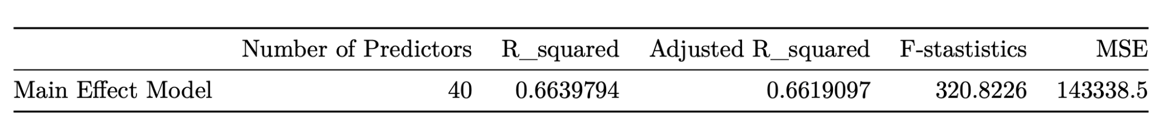
Main Effect Model

Slide 16
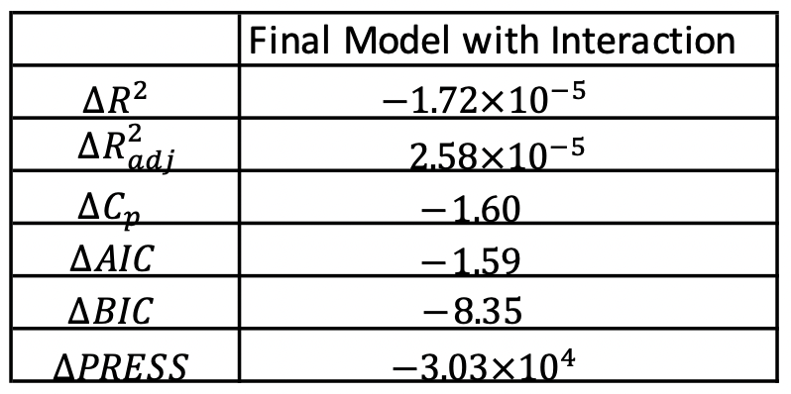
Interaction Model
Add the interaction term between Hour and Temperature.
Stepwise Regression Based on AIC:
Adjusted R Squared increases
AIC, BIC and PRESS decreases
Notes:
Now we improve our model by adding interaction terms. After researching and trying out all interaction terms, we find the one between hour and temperature is the best.

Slide 17
Interaction Model
Better than Main Effect Model!
Notes:
So we end with adjusted R squared of 0.73 which is better than main effect model.

Slide 18
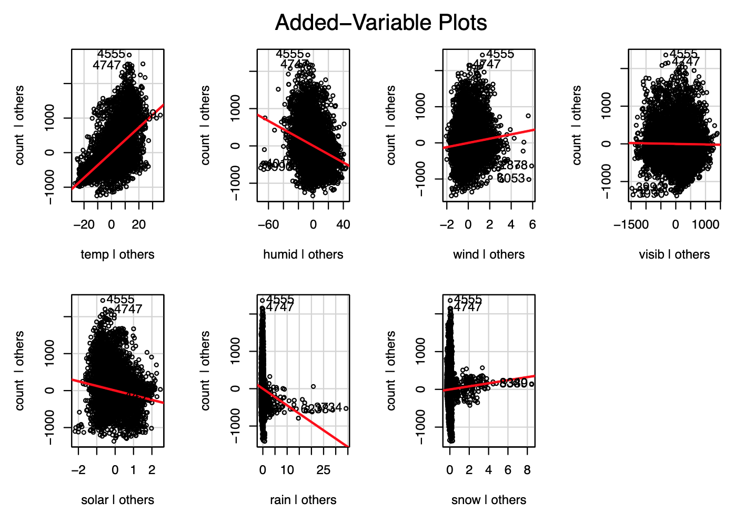


Power Model
Add rain and snow with square root transformation
Notes:
Lastly we add power terms to improve the model. We notice the rain and snow plots are squished around 0, so we apply a square root transformation

Slide 19
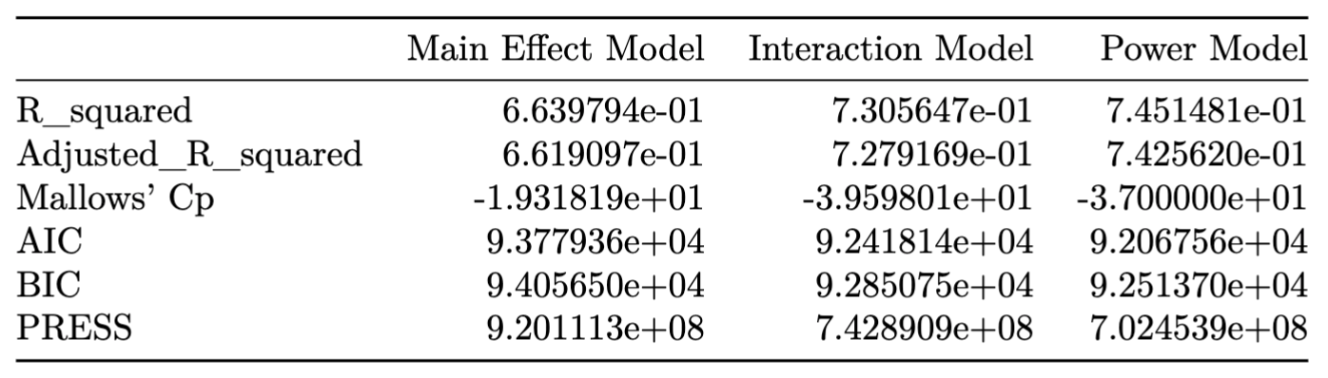
Final Model
Prediction power increased from .662 to .743!
Notes:
From the model selection criteria, we see the power model performs best for almost all of them. So power model is our final model.

Slide 20
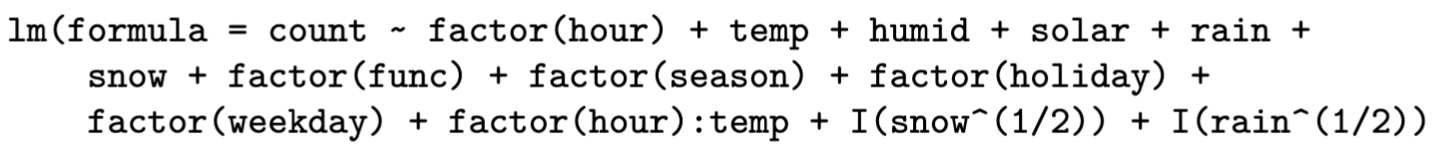
Final Model
Notes:
Our final model now contains the variables from the interaction model and the square root of snow and rain

Slide 21
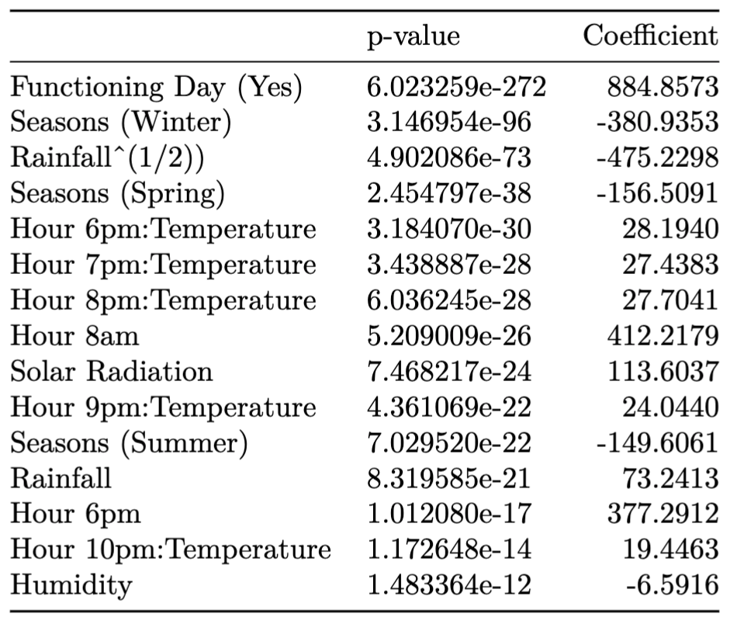
Final Model
Notes:
Here are the top 15 significant predictors of our final model. For example, about 412 more bikes are rented at 8am compared to midnight.

Slide 22
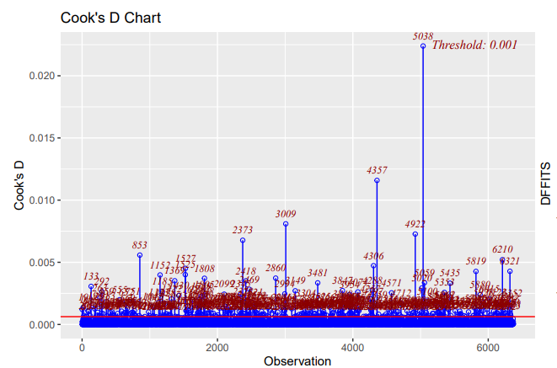
Model Diagnostics
Notes:
Using graphical diagnostics like Cook’s distance, we see the suspected influential points. We then extract the influential points using DFBETAS and threshold of 0.2. Retraining the data after this leads to the regression coefficients changing.

Slide 23
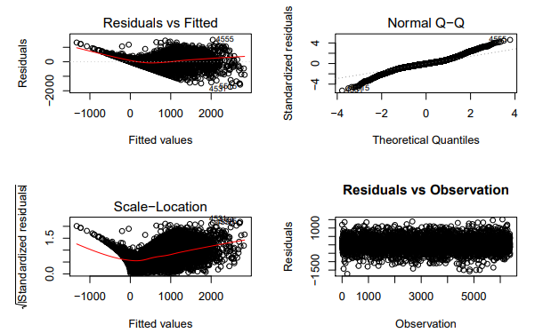
LINE Assumptions
Notes:
Examining the residual diagnostics reveals that the assumptions of linearity, normality, and constant variance are violated, but the independent error term assumption is satisfied.

Slide 24
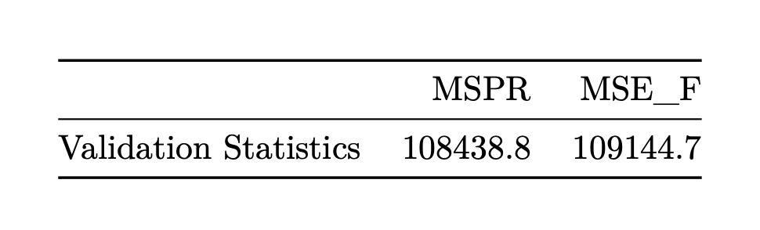
Model Validation
Notes:
Additionally, the MSPR and MSE_F values are relatively close to each other indicating that the model is valid

Slide 25
3
So What?
Notes:
Okay, so what does this mean for you, Jimin?

Slide 26
Future Directions
Impact
Limitations
74% prediction power!
-380 bikes in Winter
-156 in Spring
-150 in Summer
+412 at 8am
+780 on Func day
+20 per +1C of temp
Chronological data violates independence
12th day of each month is missing
LINE assumptions could be fixed using WLS or Boxcox
Province, district or station specific data
Time series analysis (e.g. ARIMA or SARIMA)
Notes:
Our final model has 74% prediction power. Significant predictors include seasons, 8am, functional day, temperature. Limitations include violation of LINE assumptions and missing data. As for future directions, we could predict district or station bike counts and perform time series analysis.

